Slide 1


LOGO HI DOCTOR

Slide 2


HI DOCT R
Sign up!
Already have an account?
Sign in.

Slide 3
English v
HI DOCT R
Full Name
Gender v
Date of birth v
Phone number
Username
Email
Password
Confirm password
Save
Already have an account? Sign in.

Slide 4
English v
HI DOCT R
Username, email, or phone number
Password
Sign In
Forgot your password?
Don’t have an account? Sign up.

Slide 5







HI DOCT R
Hospital
Doctor
Help
My acc
Find Hospital or Clinic
Popular
Near Me
RS Immanuel
Jalan Raya Kopo No. 161, Situsaeur, Bojongloa Kidul, Kota Bandung, Jawa Barat
10Km
25mnt
RS Immanuel
Jalan Raya Kopo No. 161, Situsaeur, Bojongloa Kidul, Kota Bandung, Jawa Barat
10Km
25mnt
RS Immanuel
Jalan Raya Kopo No. 161, Situsaeur, Bojongloa Kidul, Kota Bandung, Jawa Barat
10Km
25mnt
RS Immanuel
Jalan Raya Kopo No. 161, Situsaeur, Bojongloa Kidul, Kota Bandung, Jawa Barat
10Km
25mnt
<< Prev 1 2 3 4 5 6 7 8 9 next >>

Slide 6









HI DOCT R
Hospital
Doctor
Help
My acc
Find Your Doctor
General practitioner
Dentist
Surgeon
Internist
Obgyn
Pediatrics
Neurologist
ENT specialist
Psychiatrist

Slide 7





HI DOCT R
Hospital
Doctor
Help
My acc
Find Your Doctor
Beautycian
Dermatology
Oncologist
ophtamologist
Orthopedist
Nutritionist

Slide 8
HI DOCT R
Hospital
Doctor
Help
My acc
Hospital >
Doctor >
My Acc >
Terms and Conditions v

Slide 9


HI DOCT R
Hospital
Doctor
Help
My acc
Justin Drew Bieber
@justinbieber
Email: justindrewbieber@gmail.com
Phone number: +6281394980513
Date of birth: March, 01 1994
Address: Palapa Street No 28, Bandung, West Java. 40285
Allergic: -
Medical History: Stomach disorder
Change Password: **********
Edit
Log out

Slide 10


HI DOCT R
Hospital
Doctor
Help
My acc
Find Your Doctor
Rating
Popular
Near Me
dr. Indrarini Tiksnowati SpKK (7)
Jalan Raya Bojongsoang No. 128, Bojongsoang, Kabupaten Bandung, Jawa Barat
Dermatologist
2,5Km
10mnt
dr. Indrarini Tiksnowati SpKK (7)
Jalan Raya Bojongsoang No. 128, Bojongsoang, Kabupaten Bandung, Jawa Barat
Dermatologist
2,5Km
10mnt
dr. Indrarini Tiksnowati SpKK (7)
Jalan Raya Bojongsoang No. 128, Bojongsoang, Kabupaten Bandung, Jawa Barat
Dermatologist
2,5Km
10mnt
dr. Indrarini Tiksnowati SpKK (7)
Jalan Raya Bojongsoang No. 128, Bojongsoang, Kabupaten Bandung, Jawa Barat
Dermatologist
2,5Km
10mnt
<< Prev 1 2 3 4 5 6 7 8 9 next >>

Slide 11
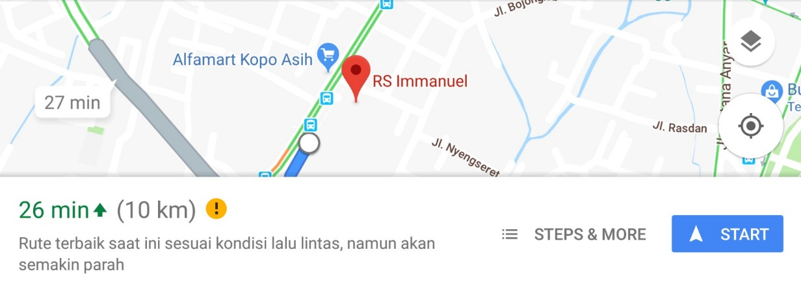
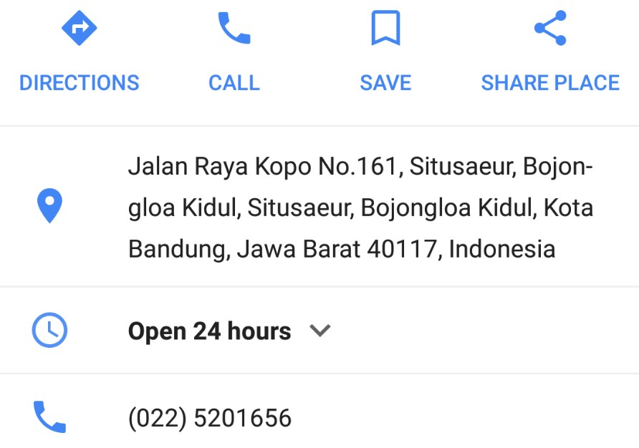
HI DOCT R
Hospital
Doctor
Help
My acc
Find Hospital or Clinic
Popular
Near Me
RS Immanuel
Jalan Raya Kopo No. 161, Situsaeur, Bojongloa Kidul, Kota Bandung, Jawa Barat
10Km
25mnt
^
<< Prev 1 2 3 4 5 6 7 8 9 next >>
v

Slide 12
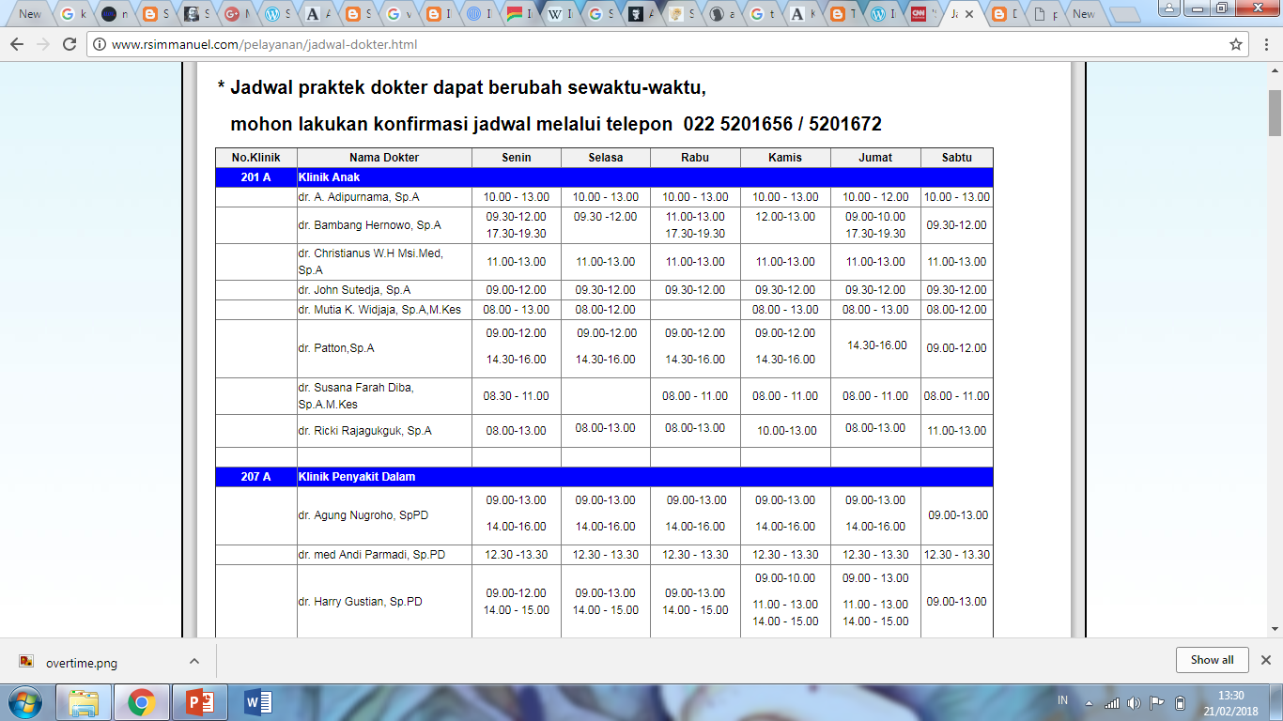
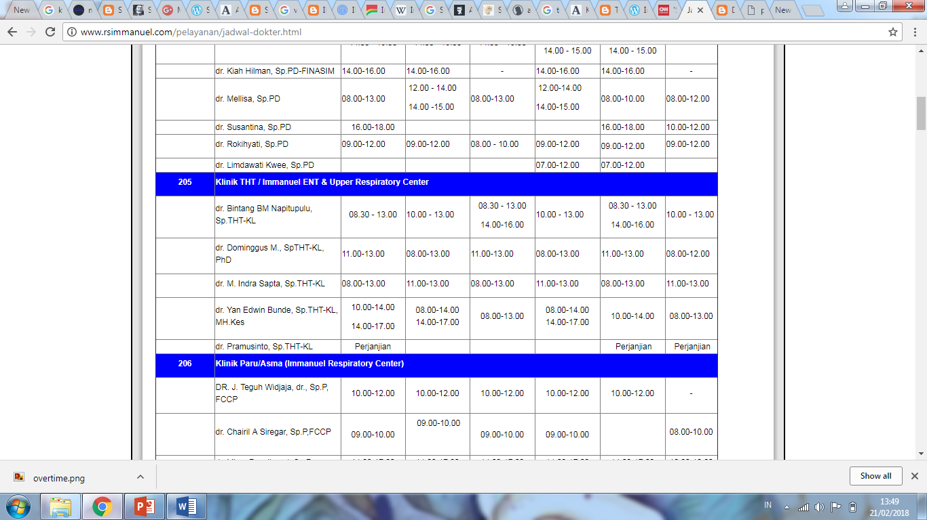
HI DOCT R
Hospital
Doctor
Help
My acc
Find Hospital or Clinic
Popular
Near Me
RS Immanuel
^
V

Slide 13

HI DOCT R
Hospital
Doctor
Help
My acc
Find Your Doctor
Popular
Near Me
dr. Indrarini Tiksnowati, Sp.KK 4,5 (7)
Jalan Raya Bojongsoang No. 128, Bojongsoang, Kabupaten Bandung, Jawa Barat
Dermatologist
2,5Km
10mnt
Jalan Raya Bojongsoang No. 128, Bojongsoang, Kabupaten Bandung, Jawa Barat
Open : 7am – 5pm
<< Prev 1 2 3 4 5 6 7 8 9 next >>
(022) 7303850
Schedule
V

Slide 14
HI DOCT R

